Slide 1


Executive Summary A review of Airline Safety
By : Yousof rahimian

Slide 2
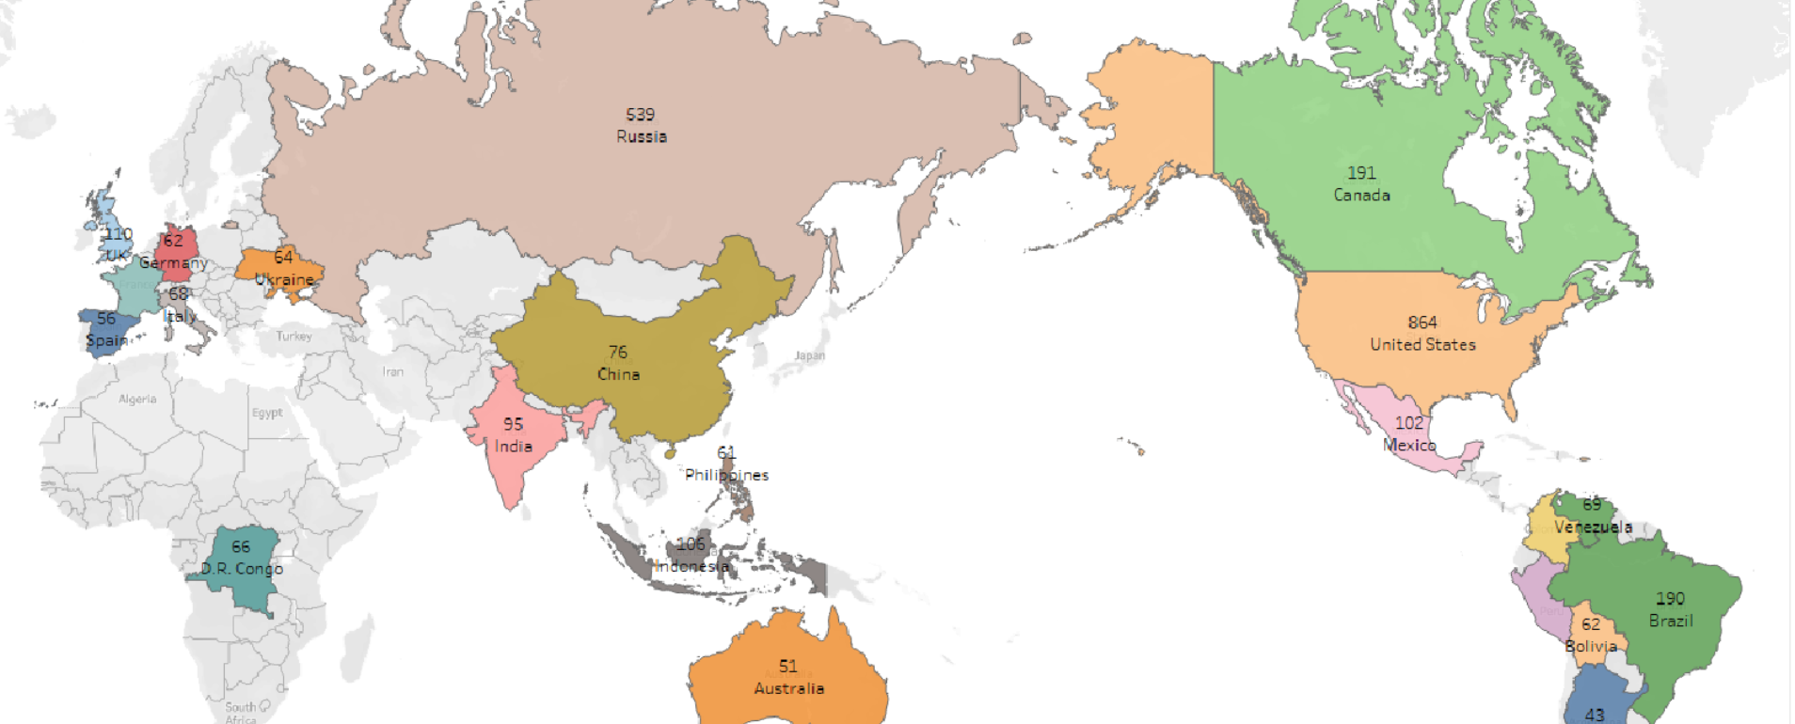
Countries with highest number of fatal civil airliner accidents from 1945 to 2022

Slide 3
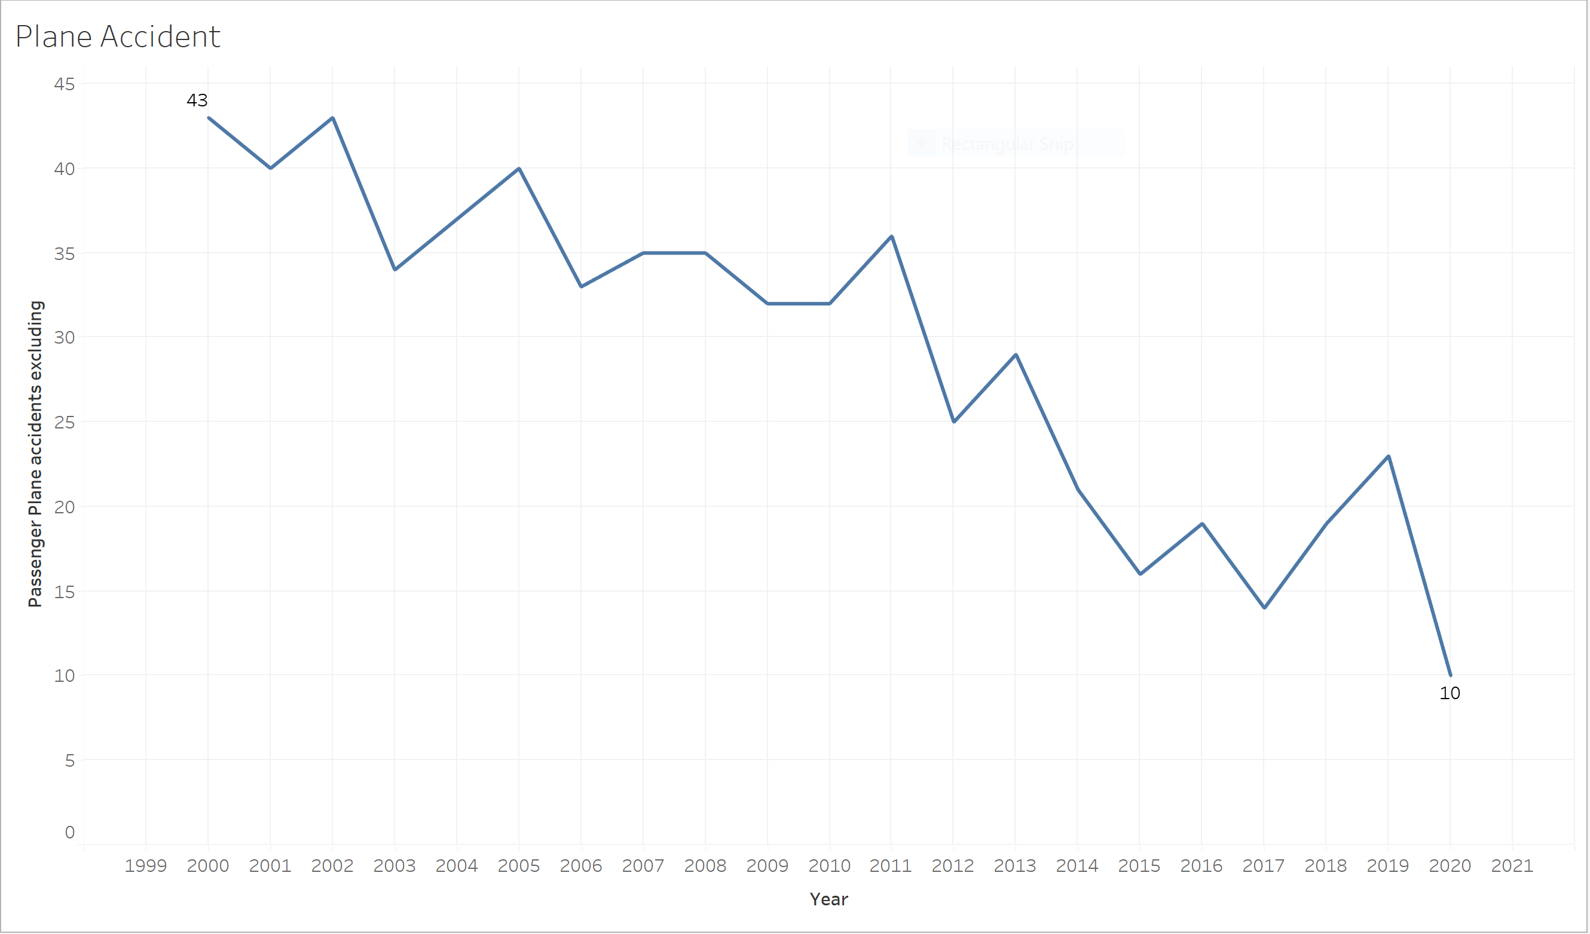
Plane Accident From 2000 to 2020

Slide 4
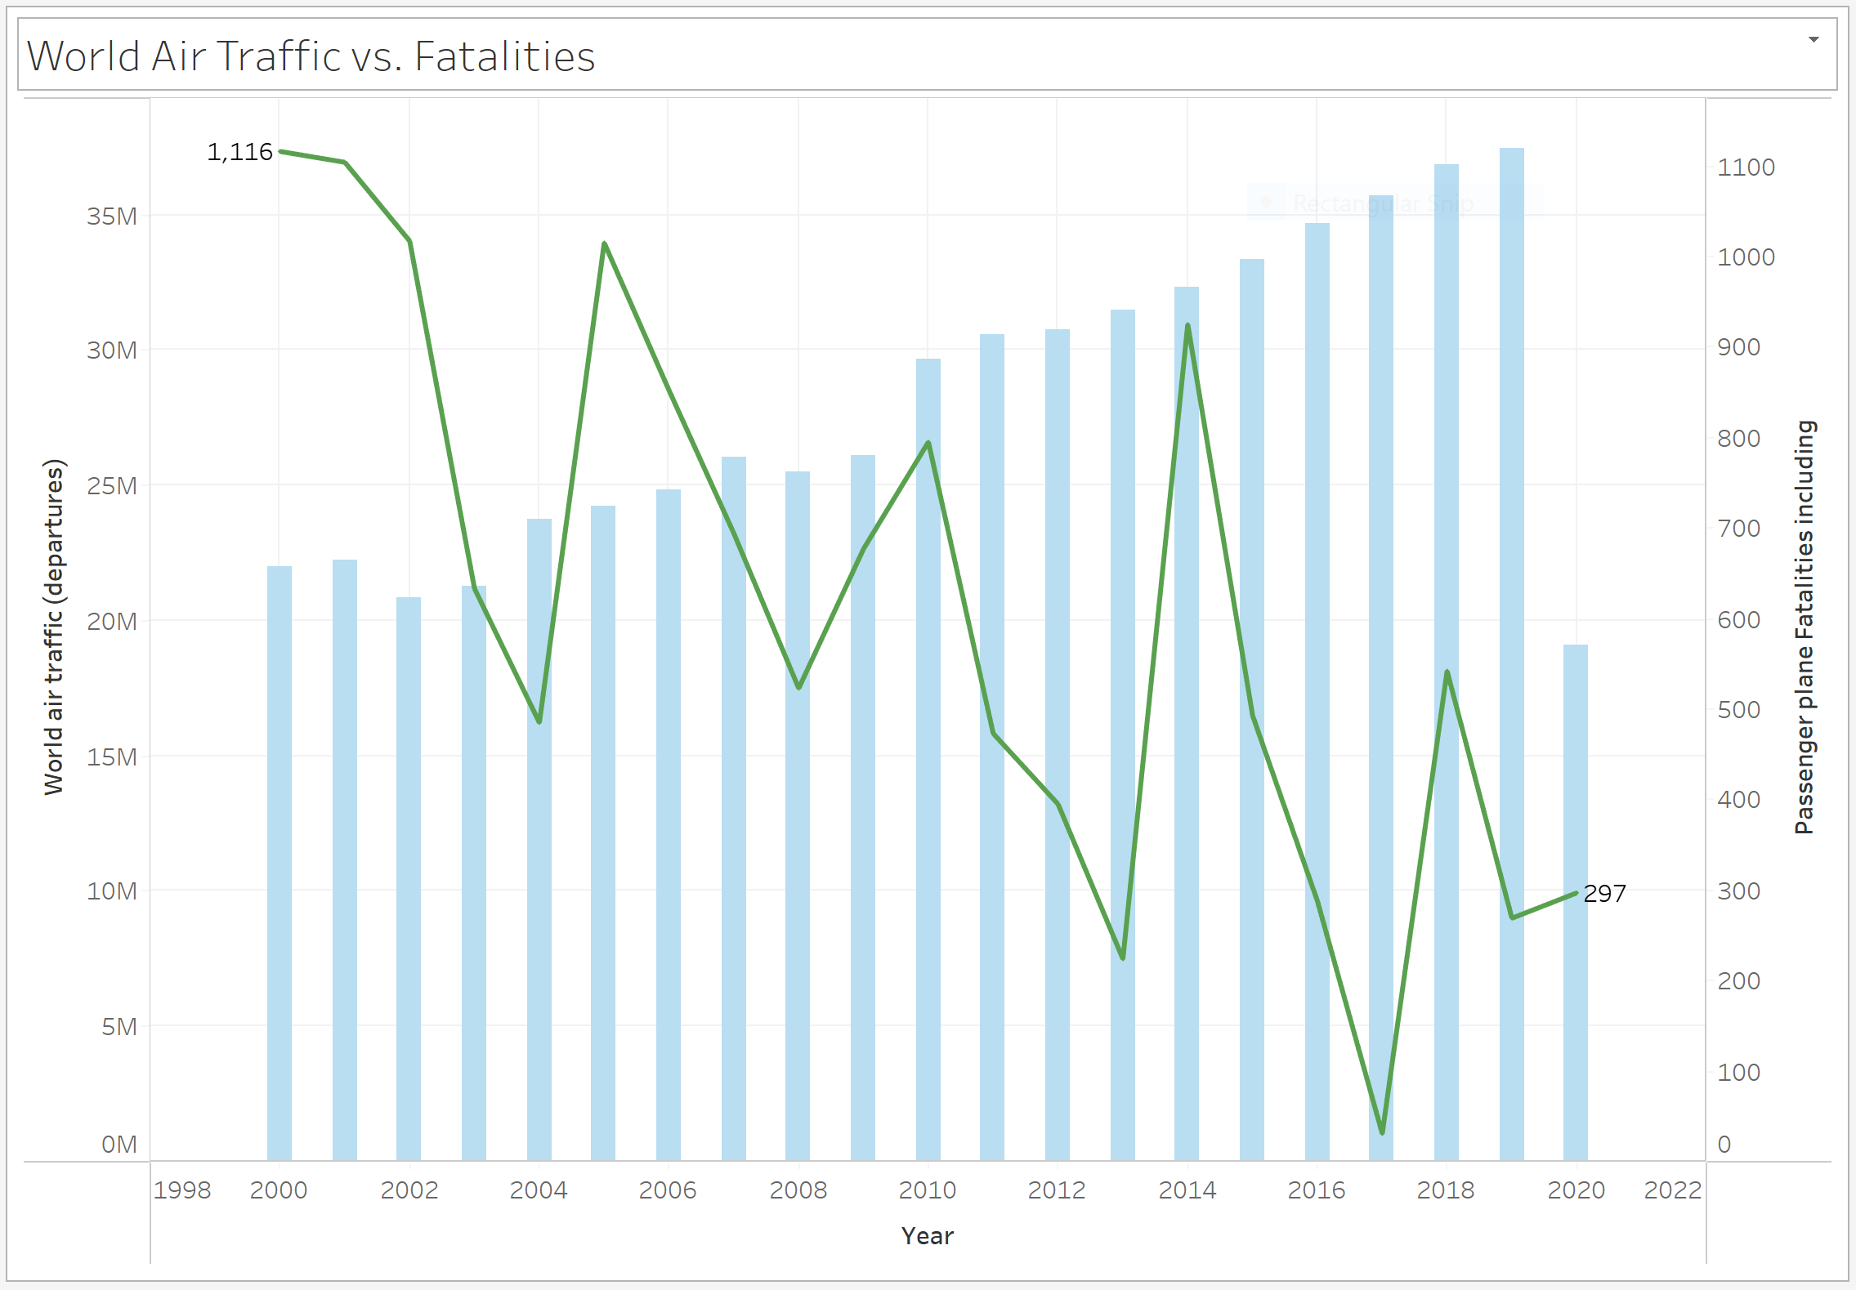
World Air Traffic vs. Fatalities From 2000 to 2020

Slide 5
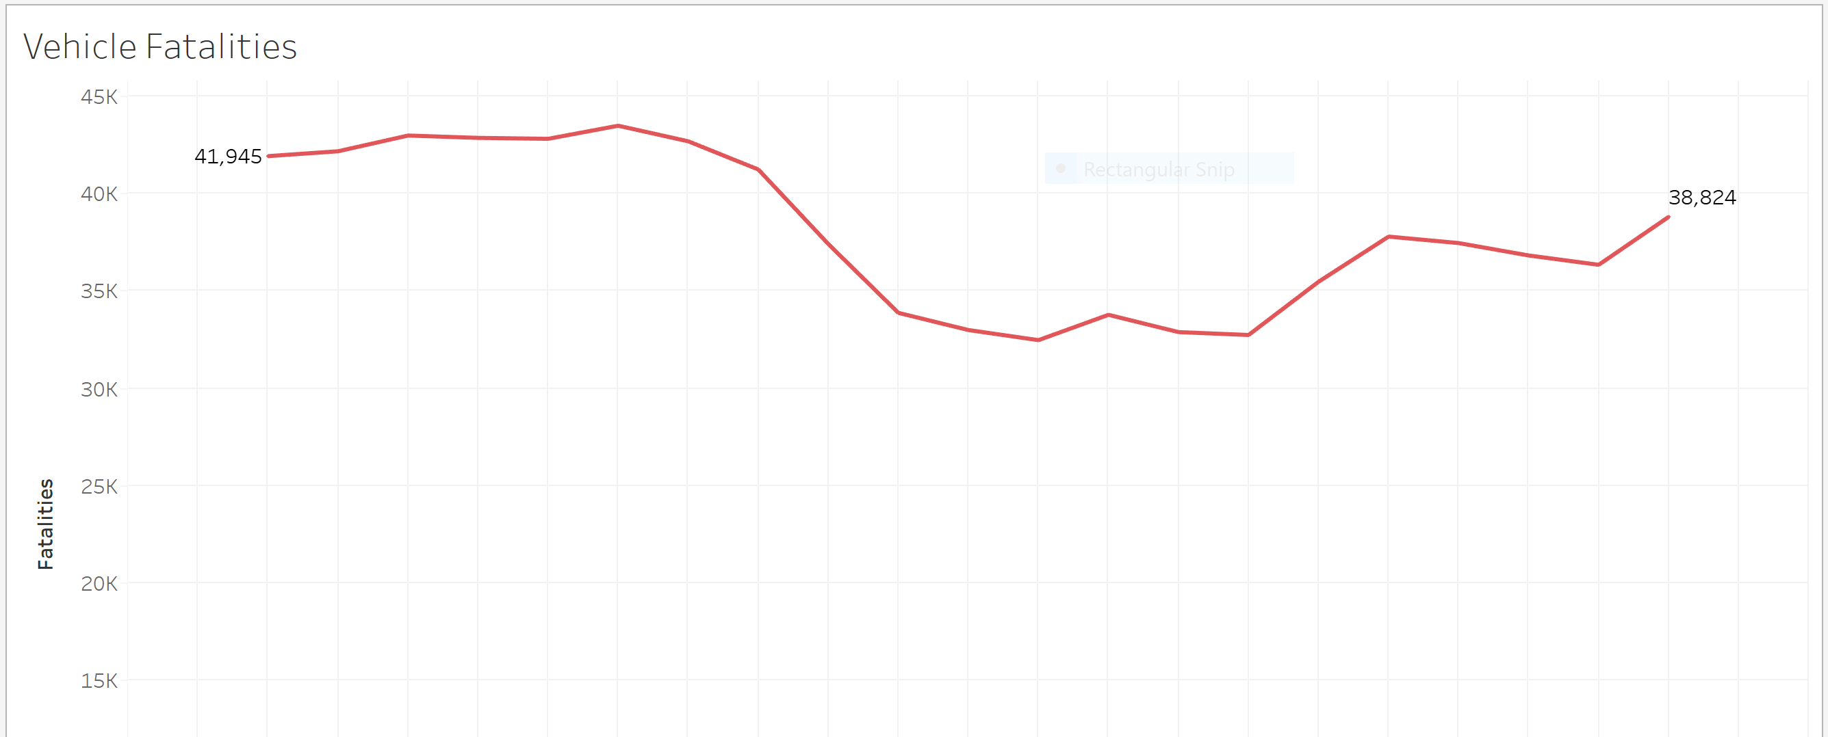
Vehicle Fatalities from 2000 to 2022

Slide 6
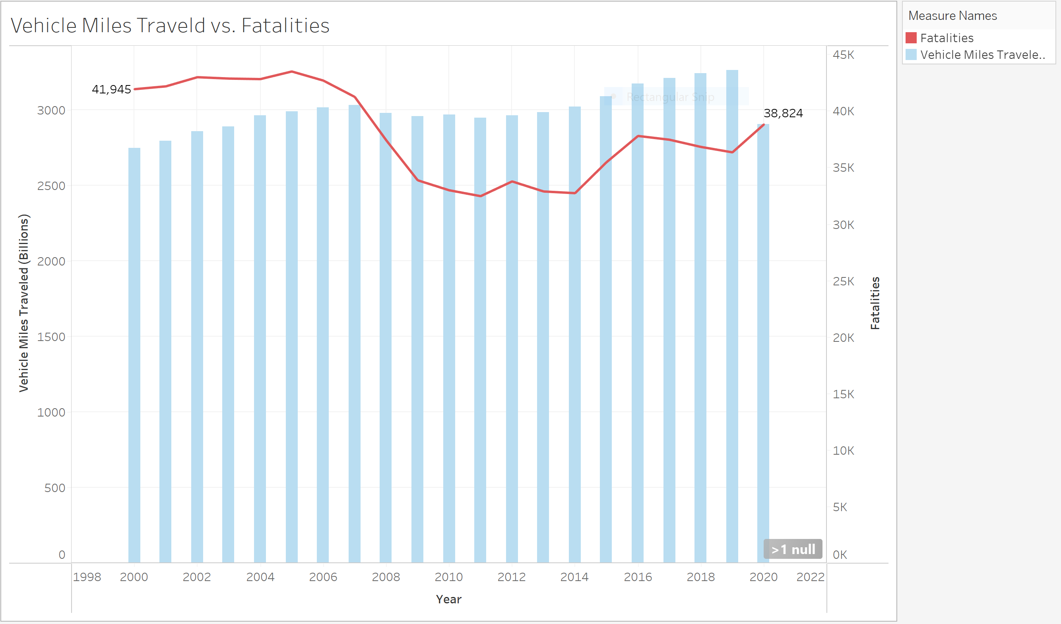
Vehicle Miles Travel vs. Fatalities

Slide 7
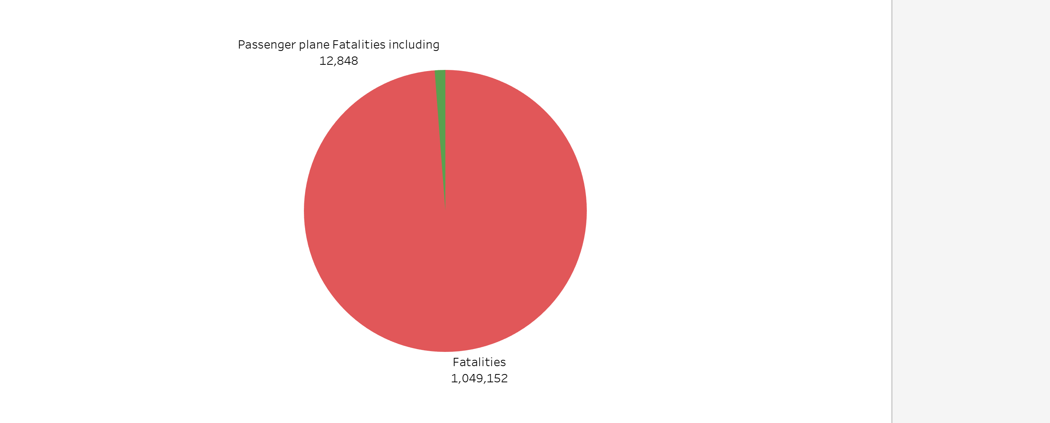
Vehicle Fatalities vs. Passenger Plane Fatalities (2000 – 2020)

Slide 8
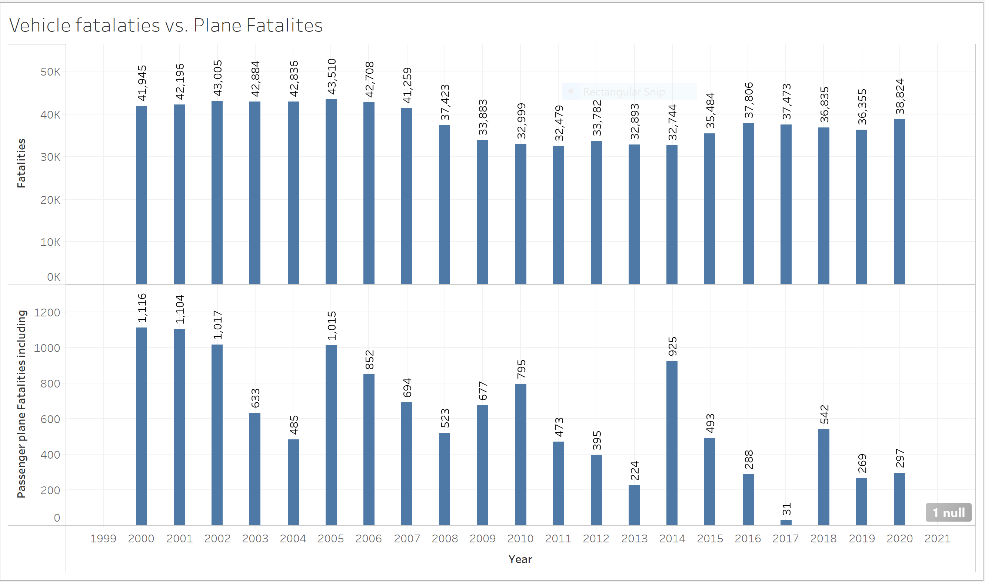
Vehicle Fatalities vs. Plane Fatalities

